Slide 1
Console I/O, File I/O

Slide 2
Objective of This Session
Distinguish between stream and file
Describe Consol I/O
  Unformatted input output
  Formatted input output
Describe file I/O
  Open a file, use a file, close file
  More about open() : modes
  Random file access

Slide 3
INTRODUCTION
C++ uses the concept of stream and stream classes to implement I/O operations with the console and disk files.
The I/O system is designed to work with a wide variety of devices including terminals, disks and tape drives. Although each device is very different the I/O system supplies an interface known as stream, that is independent of the device being accessed.

Slide 4
C++ I/O features
C++ defines its own object oriented I/O system
C++ I/O system supplies consistent interface to the programmer independent of actual device
A stream is logical device that produces or consumes information

Slide 5
Data Stream
I/P
Device
extraction from I/P stream
Input Stream
Program
O/P
Device
insertion into O/P stream
Output Stream

Slide 6
STREAMS
A stream is sequence of bytes.
It acts as a source from which the input data can be taken and acts as a destination to which output data can be sent.
The source stream is called the input stream and the destination stream is called output stream.
The data in the input stream can come from the keyboard or any other storage device.
Similarly the data in the output stream can go to the screen or any other storage device.

Slide 7
TYPES OF STREAM
Two types of stream :
Text stream,
Binary stream
  Text stream is sequence of characters
  Binary stream is sequence of bytes, no character translation

Slide 8
Stream class for console I/O
ios
istream
ostream
iostream
include <iostream.h>

Slide 9
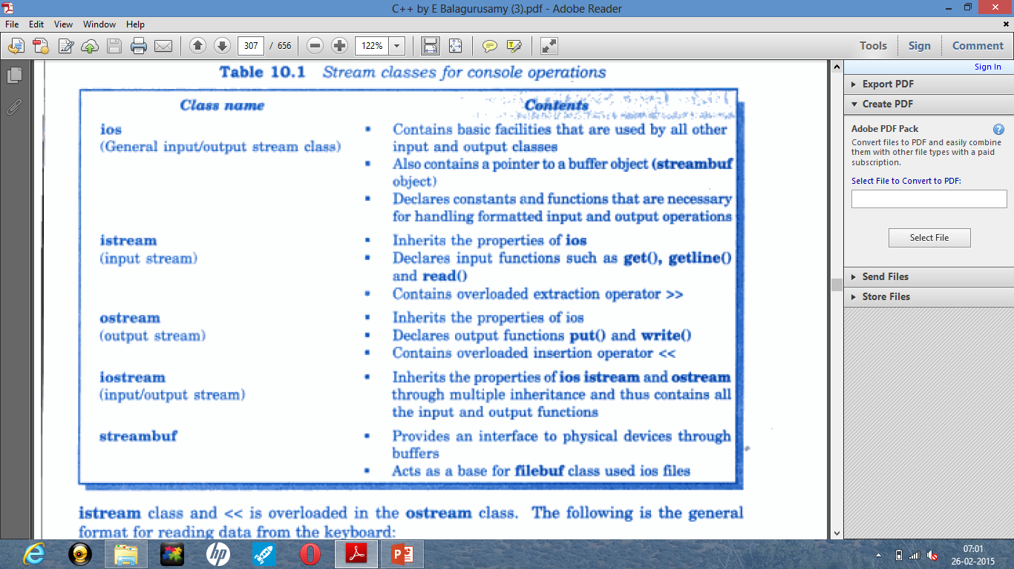

Slide 10
Unformatted I/O Operations
>> and << are overloaded for all built-in data types in corresponding istream and ostream classes
Use get()/put() to fetch/display a character including blank space, tab and newline character
  Use cin.get();
  Use cout.put(ch);
Use getline() / write() to read / write a whole line of text followed by newline
  Use cin.getline(line, size);
  Use cout.write(line, size);

Slide 11
FORMATTING THE OUTPUT
C++ supports a number of features that could be used for formatting the output.
These feature include:
    Ios class functions and flags
    Manipulators
    User-defined output functions

Slide 12
Using ios class
width() specify field width
precision() specify number of digits after decimal
point
fill() specify character to be used to fill
unused field
setf() used to set flags for say left
justification / right justification
unsetf() clear the set flags

Slide 13
Using Manipulators
setw() specify field width
setprecision() specify number of digits after decimal point
setfill() specify character to be used to fill
unused field
setiosflags() used to set flags for say left
justification / right justification
resetiosflags() clear the set flags
include <iomanip.h>

Slide 14
Using width(), precision(), fill()
cout.width(5); cout<<setw(5);
cout<<511; cout<<511;
cout.width(5); cout<<setw(5);
cout<<15; cout<<15;
 |  | 5 | 1 | 1 |  |  |  | 1 | 5

Slide 15
Using setf()
Syntax : cout.setf (arg1, arg2);
arg1 is known as formatting flag of ios class
arg2 is known as bitfield, specifies the group to which formatting flag belongs

Slide 16
Using setf()
Formatting Flags Bit field
ios::left adjustfield
ios::right adjustfield
ios::scientific floatfield
ios:fixed floatfield
ios::dec basefield
ios::oct basefield
ios::hex basefield

Slide 17
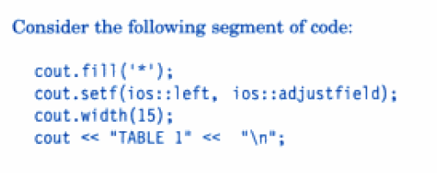
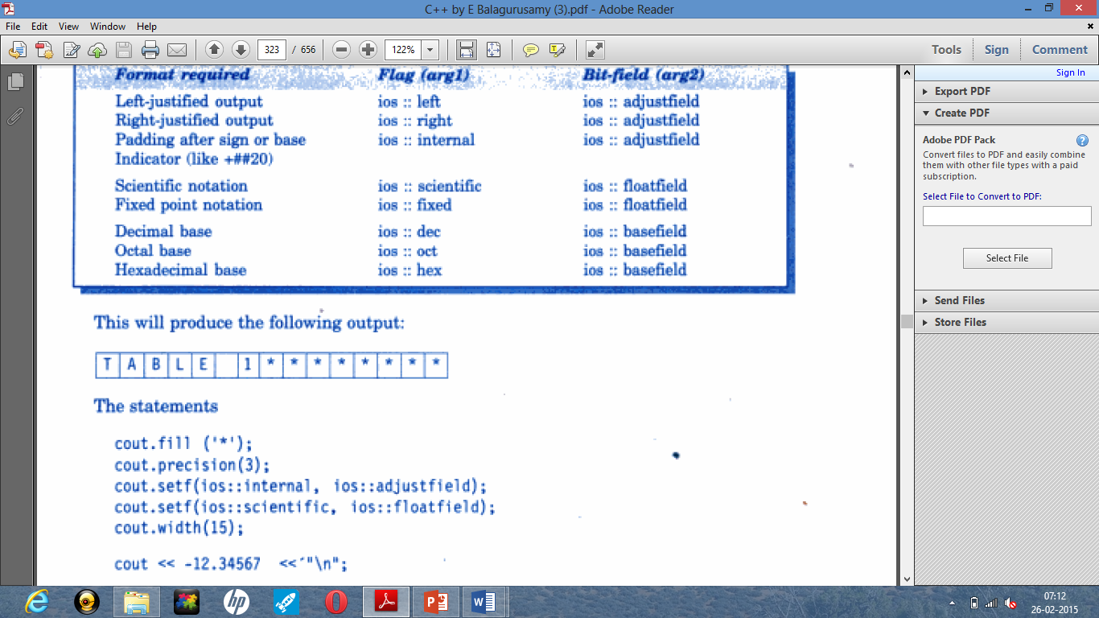

Slide 18
Using setf()
few more formatted flags for which no bitfield is required
Formatted Flags Description
ios::showpos print + before positive
numbers
ios::showpoint show trailing decimal point
and zeros
ios::uppercase use uppercase letters for hex
output

Slide 19
Example of Formatted I/O
{
cout.setf(ios::showpoint);
cout.setf(ios::showpos);
cout.precision(3);
cout.setf(ios::fixed, ios::floatfield);
cout.width(10);
cout<<275.5<<“\n”;
}
+ |  |  | 2 | 7 | 5 | . | 5 | 0 | 0

Slide 20
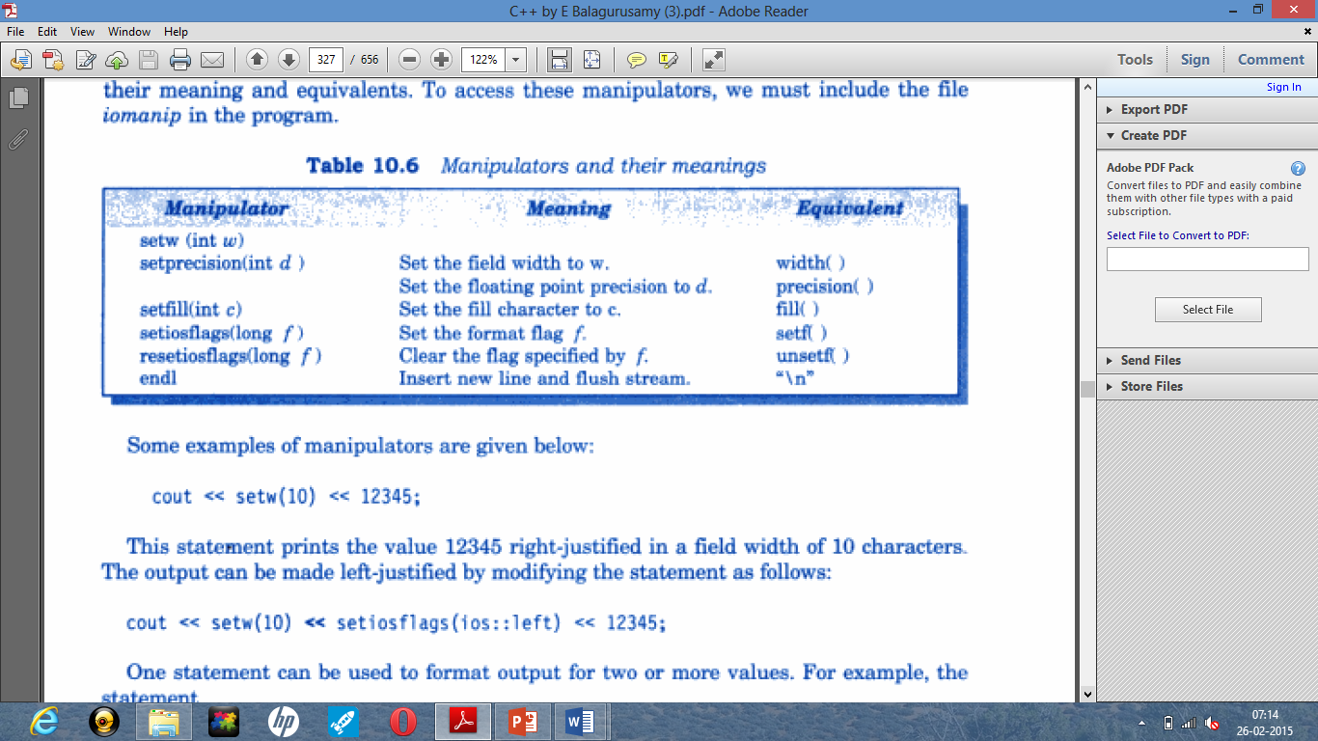
MANIPULATORS

Slide 21
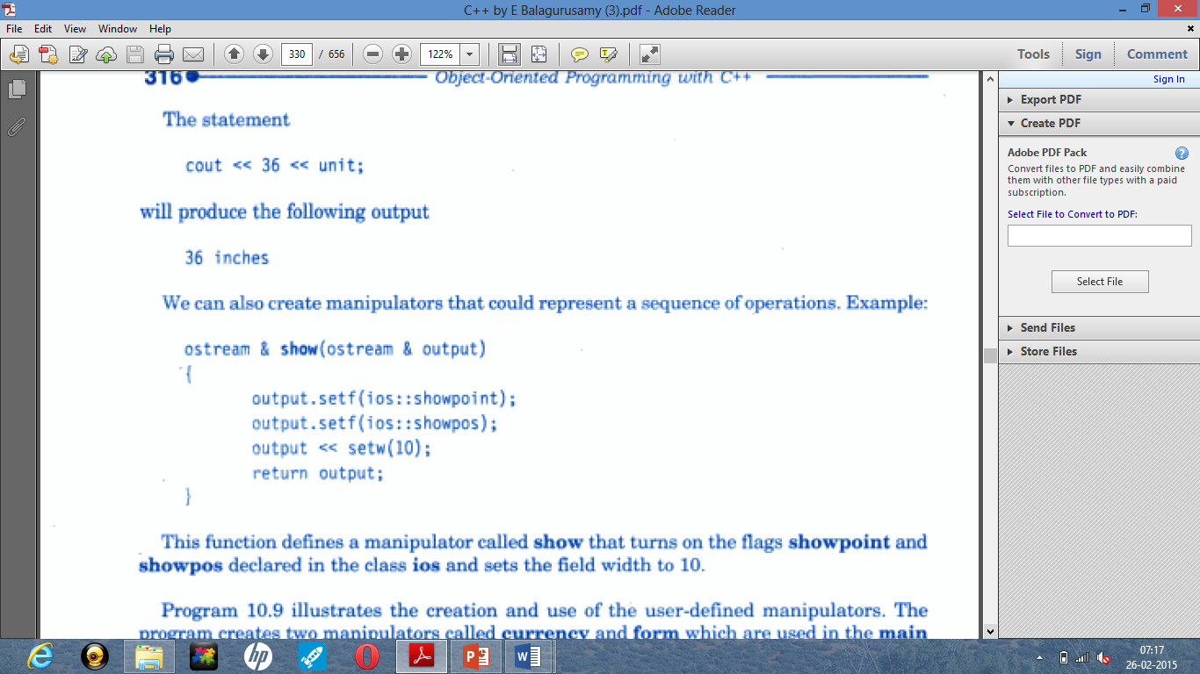

Slide 22
FILE I/O

Slide 23
INTRODUCTION
Streams provide a uniform way of dealing with data coming from the keyboard or the hard disk and going out to the screen or hard disk. To open and close files, you create ifstream and ofstream objects.
the particular objects used to read from or write to files are called ofstream objects.
These are derived from the iostream objects you've been using so far.

Slide 24
File I/O
Data which outlives the program is stored on a disk in the form of files
A file is a collection of related data stored on a disk

Slide 25
Data Flow for File I/O
Disk
Program with File I/O operations
KBD
File
Write into file
cin
Screen
Program with File I/O operations
cout
read from file

Slide 26
Stream Classes for File I/O
ios
istream
ostream
iostream
ifstream
ofstream
iofstream
include <fstream.h>

Slide 27
STREAM CLASSES
ios (General input/output stream class)
  Contains basic facilities that are used by all other input and output classes.
  It also contains a pointer to a buffer object (streambuf object).
  Declares constants and functions that are necessary for handling input and output operations.
istream (input stream)
  Inherits the properties of ios.
  Declares input functions such as get(), getline() and read()
  Contains overloaded extraction operator >>.

Slide 28
ostream (output stream)
  Inherits the properties of ios.
  Declares output functions such as put(), write().
  Contains overloaded insertion operator <<.
iostream (input/output stream)
  Inherits the properties of ios, istream and ostream through multiple inheritance and thus contains all the input and output functions.
streambuf
  Provides the interface to physical devices through buffers.
  It acts as a base for filebuf class used in files.

Slide 29
CLASSES FOR FILE STREAMS
Class Contents
filebuf Its purpose is to set the file buffers to read and write
fstreambase Provides operations common to file streams.
ifstream Provides input operations
ofstream Provides output operations
fstream Provides support for simultaneous
Input and output operations

Slide 30
Handling Files
To read / write data to /from a file
  Open a file
  Do read write operations
  Close file
File can be opened in two ways
  Using construction function of a class
  Using member function open() of class

Slide 31
Using constructor to open a file
{
ofstream outfile(“result”);
// outfile is object of class ofstream
// constructor will open it in write mode
char ch = ‘ ‘;
outfile.put( ‘1’ ).put( ‘)’ ).put( ch );
outfile << “1 + 1 = “ << (1 + 1) << end1;
}
inserts in result file
1) 1 + 1 = 2
When file objects goes out of scope corresponding destructor is called which closes the file

Slide 32
Using open() to Open File
{
ofstream outfile; // create output stream
outfile.open(“Result1”); // open a file
…
outfile.close(); // to disconnect stream
outfile.open(“Result2”);
…
outfile.close();
}
To handle multiple files simultaneously create more streams
e.g. ifstream fin1, fin2;

Slide 33
More About open() : mode
Parameter Meaning
ios::app Append to an end of file
ios::binary Binary file
ios::in Open file for reading only (default arg)
ios::nocreate Open fails if the file does not exist
ios::noreplace Open fails if the file already exists
ios::out Open file for writing only (default arg)
The mode can combine two or more parameters using bitwise OR
  e.g.: fout.open(“data”, ios::app | los::nocreate)

